Slide 1


DEPARTMENT OF COMPUTER SCIENCE AND ENGINEERING
CS8811 PROJECT WORK
Virtual Net banking System with Administrative Module
Guided by: Dr. G Senthil Kumar,M.E,Ph.D.,
Presented by: Joseph Winston B(211418104104)
Venkata Sai Guthala(211418104073)
Batch Number:E19
Domain: Big Data
1/26

Slide 2
ABSTRACT
A computer based Banking system is designed to handle all the primary information required to calculate monthly statements of customer account which include monthly statement of any month. Separate database is maintained to handle all the details required for the correct statement calculation and generation.
This project intends to introduce more user friendliness in the various activities such as updating records, maintenance, and searching. The searching of record has been made quite simple as all the details of the customer can be obtained by simply keying in the identification or account number of that customer. Similarly, record maintenance and updating can also be accomplished by using the account number with all the details being automatically generated. These details are also being promptly automatically updated in the master file thus keeping the record absolutely up-to-date.

Slide 3
EXISTING SYSTEM
In the existing system the transactions are done only manually but in proposed
system we have to computerize all the banking transaction using the software Banking system.
DISADVANTAGES OF EXISTING SYSTEM
Lack of security of data.
More man power.
Time consuming.
Consumes large volume of pare work.
Needs manual calculations.
No direct role for the higher officials.
Damage of machines due to lack of attention.
To avoid all these limitations and make the working more accurately the system needs to be
computerized.

Slide 4
PROPOSED SYSTEM
It fulfills almost all the process requirements of any Bank from your own comfort
place
It should increase the productivity of bank or any other organization by utilizing the
working hours more and more, with minimum manpower.
The aim of proposed system is to develop a system of improved facilities. The proposed system can overcome all the limitations of the existing system. The system provides proper security and reduces the manual work.

Slide 5
ADVANTAGES OF PROPOSED SYSTEM:
The system is very simple in design and to implement. The system requires very low system
resources and the system will work in almost all configurations. It has got following features
Security of data.
Ensure data accuracy’s.
Proper control of the higher officials.
Reduce the damages of the machines.
Minimize manual data entry.
Minimum time needed for the various processing.
Greater efficiency
Better service.
User friendliness and interactive.
Minimum time required.

Slide 6
SOFTWARE AND HARDWARE REQUIREMENTS
SOFTWARE REQUIREMENTS:
Application Requirements
• Microsoft Windows XP
• PHP (Apache Tomcat 5.5)
Database Server
• My SQL 5.0.
Client and Browser
• Microsoft Internet Explorer (6+).
• Mozilla Firefox.

Slide 7
Django
Django is a high-level Python Web framework that encourages rapid development and clean pragmatic design. A Web framework is a set of
components that provide a standard way to develop websites fast and easily.
Django’s primary goal is to ease the creation of complex database-driven websites. Some well known sites that use Django include PBS, Instagram , Mozilla, Spotify.
Sql
Sql is used to store the username and passwords of the customers of our bank

Slide 8
Redis
Redis is commonly used for caching, transient data storage and as a holding area for data during analysis in Python application
Celery is a task queue with focus on real-time processing, while also supporting task scheduling. Redis is a message broker.
This means it handles the queue of "messages" between Django and Celery.
virtualenv
virtualenv is used to manage Python packages for different projects. Using virtualenv allows you to avoid installing Python packages globally which could break system tools or other projects

Slide 9
SOFTWARE AND HARDWARE REQUIREMENTS
HARDWARE REQUIREMENTS:
• Pentium IV 233MHz.
• 1Gb RAM.
• 1 Gb free hard disk space.
Communication Interface
-Client on Internet will be using HTTP/HTTPS protocol.
-Client on Intranet will be using TCP/IP protocol.
-A Web Browser such as IE 6.0 or equivalent.

Slide 10
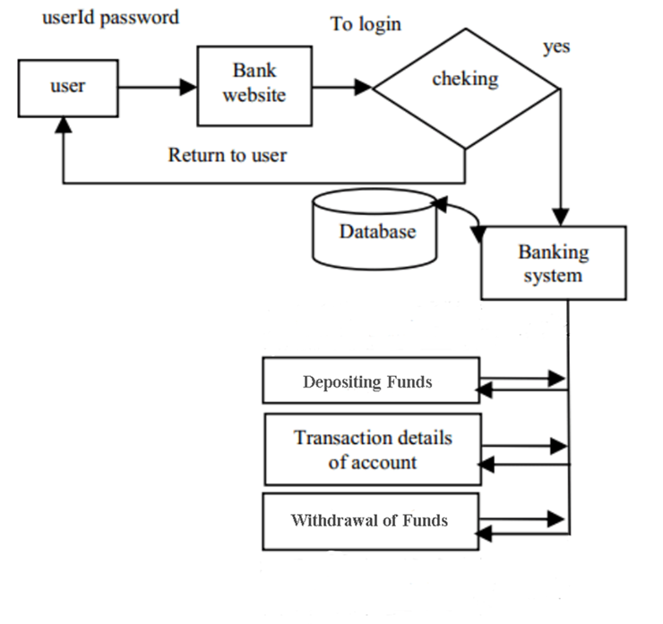
SYSTEM ARCHITECTURE

Slide 11
Data Flow Diagrams
This Diagram server two purpose.
Provides an indication of how date is transformed as it moves through the system.
Disputes the functions and sub functions that transforms the dataflow.
The Data flow diagram provides additional information that is used during the analysis of the information domain, and server as a basis for the modelling of functions.
The description of each function presented in the DFD is contained is a process specifications called as PSPEC

Slide 12
Admin Panel:
Login
Admin Login
Authentication
View customers

Slide 13
Transaction :
Transaction
Verification
Withdraw
Enquiry
Choose Transaction :
Account choose
Transaction
Current
Fixed deposit
Deposit

Slide 14
Processing:
Reporting Authority
Customer Candidate
Database Update

Slide 15
Password
Customer id
Admin id
Password
Administrator
Manages
Customer
Address
Phone no
ER-Diagram :
Age
IS
Email
Date of birth
Mini stmts
Balance_enq
Accounts_types
Funds_transfers
Perform transactions
Generate trans list
Available amount
Generate the accounts
Displays

Slide 16
Database Design
Customer AI
Field Name | Data Type | SIZE
AccountNo | Varchar | 50
A_Sno | Int | 4
UserID | Varchar | 50
AccountName | Varchar | 50
AccountType | Varchar | 50
Balance | Int | -

Slide 17
Login Details :
Field Name | Data Type | SIZE
Sno | Int | 15
UserID | Varchar | 20
Password | Varchar | 20

Slide 18
Mini_statement :
Field Name | Data Type | SIZE
UserID | Varchar | 50
T_date | Date | -
T_Id | Int | 20
T_Accountno | Int | 20
T_Amount | Int | -

Slide 19
CustomerPI
Field Name | Data Type | SIZE
UserID | Varchar | 50
FirstName | Varchar | 50
LastName | Varchar | 50
FatherName | Varchar | 50
R_Address | Varchar | 500
DOB | Varchar | 50
Age | Int | 2
Landline_No | Varchar | 20
Mobile_Phone | Varchar | 10
Nationality | Varchar | 10
Email | Varchar | 50
Occupation | Varchar | 50
O_Address | Varchar | 50
Office_phone | Varchar | 50
Employer | Varchar | 50
City | Varchar | 50
Pincode | Varchar | 50
State | Varchar | 50
Country | Varchar | 50

Slide 20
Bankdb (Transaction List):
Field Name | Data Type | SIZE
T_Id | Int | 30
AccountNo | Varchar | 50
TDate | Varchar | 50
Debit | Int | 20
Credit | Int | 20
Balance | Int | -
DepositAcct | Varchar | 50
Withdraw Acct | Varchar | 50

Slide 21
MODULES AND ALGORITHM EXPLANATION
Users of the system:
In this online internet banking system, the users are
Administrators
Consumers
Administrator: He is the super user responsible for managing system users, taking system backup, generating reports, maintaining organization details, Starting Sessions and ending Sessions and also manages various requests from different Types of users.
Providing Username, Password and other information required for the users to start an account.

Slide 22
Starting Sessions: The Administrator creates the system users and will be assigned with the different roles. He is also responsible to start the session when a particular user wants to use the system every time (It is automatically managed setup).
Managing Data Backup: The Administrator is responsible for managing entire details by taking the backup periodically. He also takes the Backup of the database in order to prevent loss of data on system crashes or in order to prevent malfunctioning. He can take a backup of entire database or a particular section.
Crash Recovery: The Administrator manages the crash recovery at the time of system crash or failure occurs.

Slide 23
Ending session: The administrator is responsible for ending the session when the particular user logged out of system (It is automatically managed setup).
Customer (Normal/others): Ordinary customers have a user name & password with which they can login into their account. They can perform all the transactions such as funds transfer, balance enquiry etc. by sitting at their home on internet.
• Login: User can login to the system by providing appropriate username and password provided by the administrator.

Slide 24
Selecting the Account: After logging in the user is provided with a screen showing the details of accounts and he selects one of the account in order to perform the transaction.
Balance Enquiry: He can view the balance left in his account, if once he has entered into his account.
Funds Transfer: Upon the request the user can transfer funds from his account to other accounts.
Mini statements: He also can take a mini statement print out upon his requirement

Slide 25
CONCLUSION
Virtual Banking System keeps the day by day tally record as a complete banking. It can keep the information of Account type, account opening form, Deposit, Withdrawal, and Searching the transaction, Transaction report, Individual account opening form, Group Account. The exciting part of this project is; it displays Transaction reports, Statistical Summary of Account type and Interest Information.

Slide 26
Thanks!

